Slide 1
TAILWIND CSS

Slide 2
What ?
A utility-first CSS framework that provide efficiency and flexibility in front-end development.
It prioritizes the use of small, single-purpose utility classes over traditional CSS frameworks.

Slide 3
Utility Class
Small CSS classes that apply specific styling properties directly to HTML elements.
=> Single-purpose
=> Reusability
=> Responsive Design

Slide 4
Installation
Step 1 - Create a new project folder
Step 2 - Initialize your project (npm init -y)
Step 3 - Install Tailwind CSS (npm install tailwindcss)
Step 4 - Create a Tailwind configuration file (npx tailwindcss init)

Slide 5
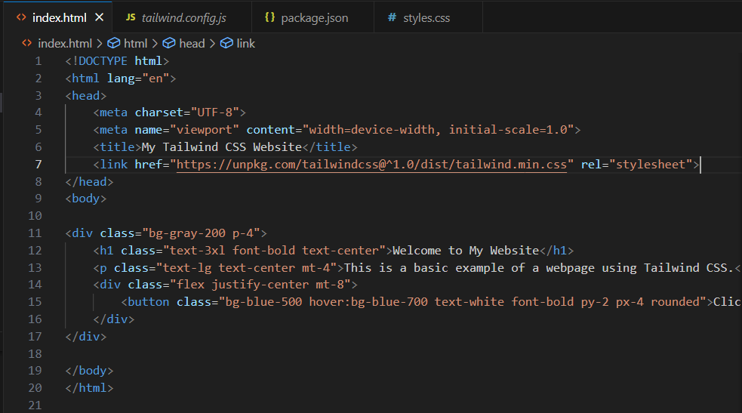
EXAMPLE

Slide 6
Advantages
Utility-first approach
Highly customizable
Low specificity
Performance
Responsive design

